Slide 1
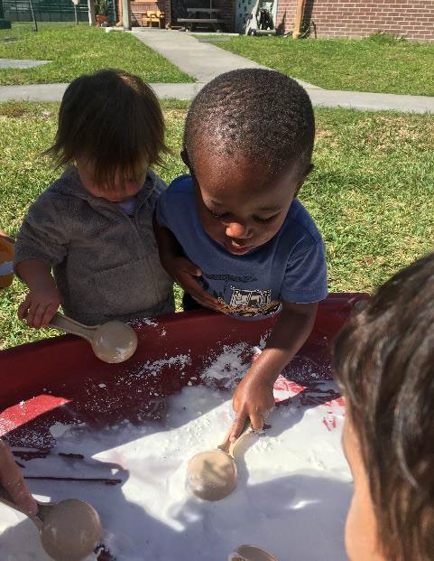
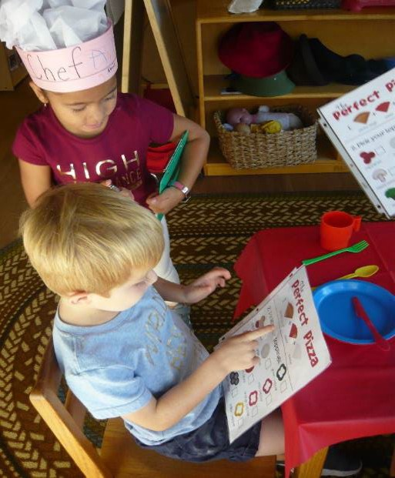
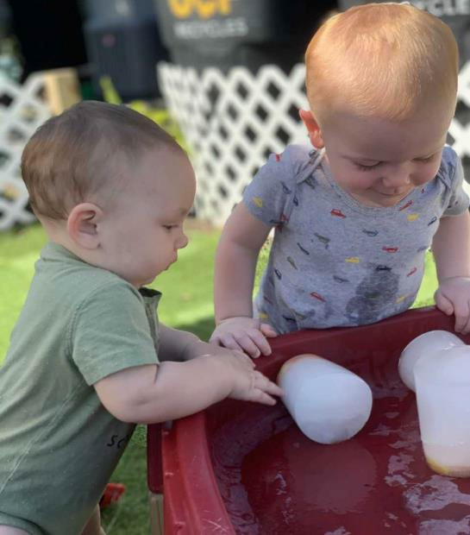
UCF Creative School for Children is honored to welcome you to our family!

Slide 2
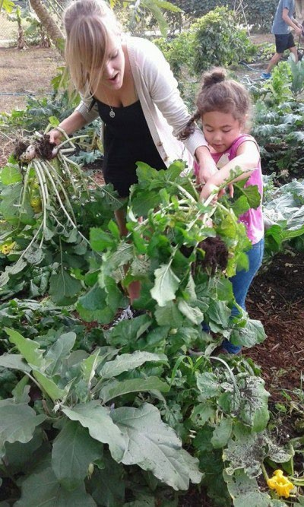
Our Mission
We strive to create a safe and educational environment providing opportunities for children to:
Discover
Explore
Grow
Develop

Slide 3
About Us
The Creative School for Children opened its doors on March 29, 1976, with 15 children enrolled
CSC is licensed by the Florida Department of Children and Family Services
CSC is accredited by the National Association for the Education of Young Children (NAEYC)
CSC is Gold Seal Accredited by the Florida Department of Children and Families

Slide 4
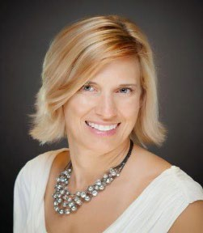
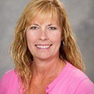
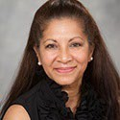
Management Staff
Suzette Turner: Ph.D. in Education and over 25 years of experience in Early Childhood Education field.
Kimberly Nassoiy: Masters in Early Childhood Education from UCF. She has been at the Creative School for Children since 2010 as the Associate Director.
Giatry Bacchus: A.S. Degree in General Education and a Bachelor’s Degree in English. Started at the Creative School for Children in 1998 as a classroom teacher.

Slide 5
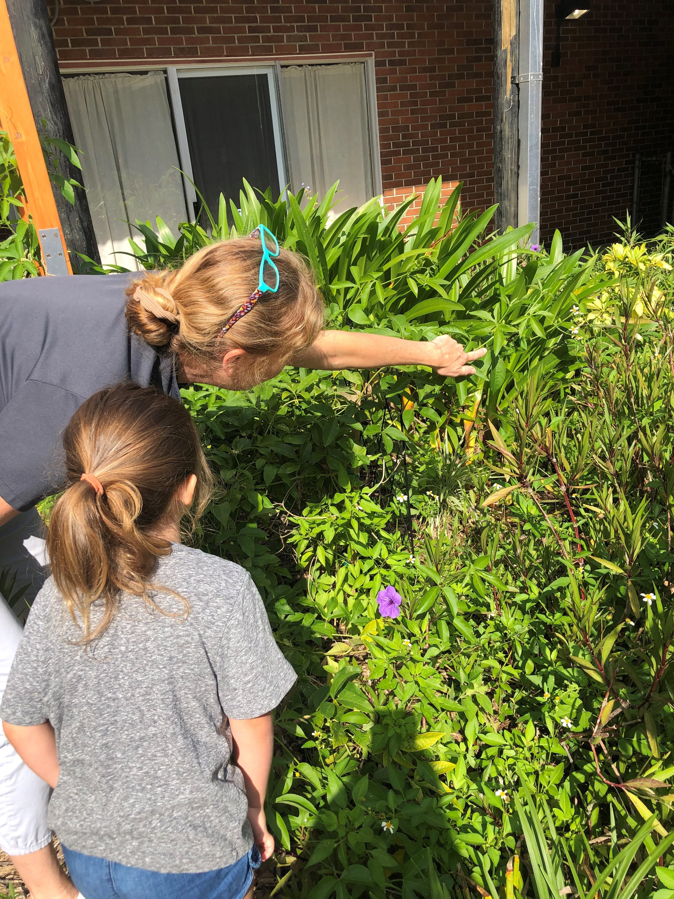
Employee Qualifications
Ensuring your child’s safety is our top priority
ALL STAFF MUST COMPLETE:
State Background Check and Fingerprinting
First Aid and Pediatric Cardiopulmonary Resuscitation (CPR) Training
Emergency Procedure and Fire Extinguisher Training
Safe Sleep/Shaken Baby Syndrome Training
Child Abuse and Neglect Course
Florida DCF Child Care 40 Hour Training

Slide 6
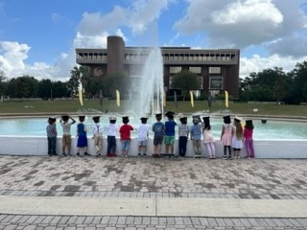
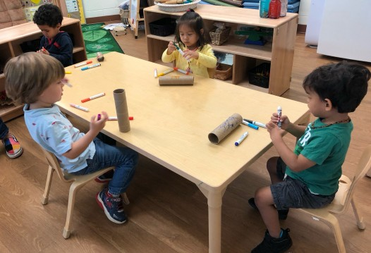
CSC Curriculum
Built on “Active and Emergent Learning” principles where children are given the opportunity to engage all five of their senses.
Engages children through the Project Approach. This approach allows us to guide them through an in-depth study of real-life topics.
Uses the latest in early childhood research
which supports our hands-on, active learning teaching model, and promotes school readiness.
Learning Centers:
Blocks/Transportation Dramatic Play (Home Living) Library (Language Arts) Math/Manipulatives Science/Sensory
Music/ Movement Creative Expression/Writing
Large Motor/Outdoor Learning

Slide 7
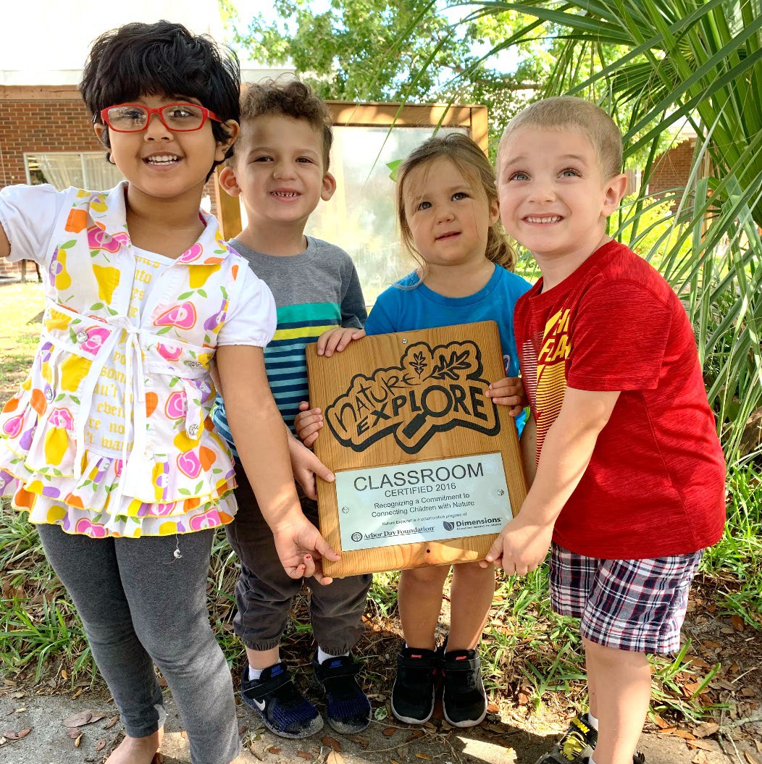
Curriculum Goals
Skills essential to life success...
- Create and encourage positive self-esteem in each child
-Develop positive social behaviors and relationships
-Expand language skills
-Grow cognitive, social-emotional, and physical development
-Encourage play in each child

Slide 8
About Our Screening and Assessment
Screening:
Ages and Stages Questionnaire: This questionnaire is used as a baseline to gauge where your child is with his/her development. As a parent, you can also use this tool to assess your child yourself.
Assessment:
Teaching Strategies Gold: We document your child's progress and work through narratives, anecdotal notes, pictures and developmental checklists.

Slide 9
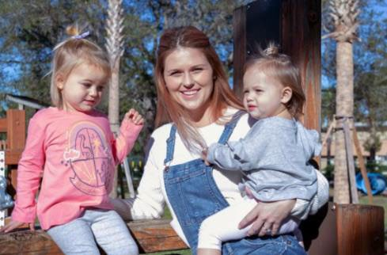
What Parents Can Expect
Open-door policy
Weekly newsletters emailed
Communication and partnership with your child's teacher
Two conferences offered annually
Compliance with national childcare standards
As an educational research facility, UCF
students may observe the classroom or your child

Slide 10
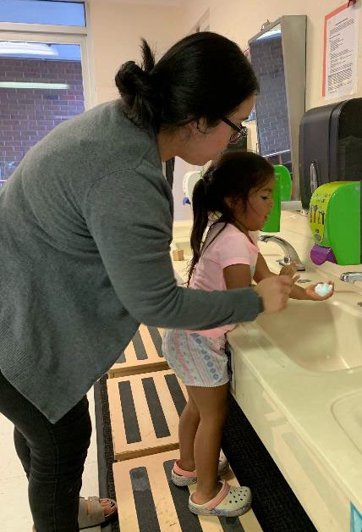
Parent's Role
Keep child’s records up to date
Clock in and out daily, using Procare
Read information provided to you including newsletters and emails.
Communication with your teacher
Wash your child’s hands upon arrival

Slide 11
Student Government Creative School Scholarship
Financial Assistance at CSC
School Readiness/ The Gardiner Scholarship Program
The CCAMPIS Grant

Slide 12
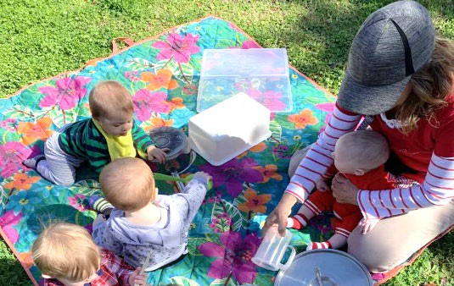
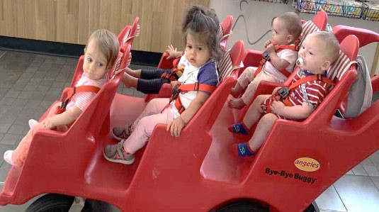
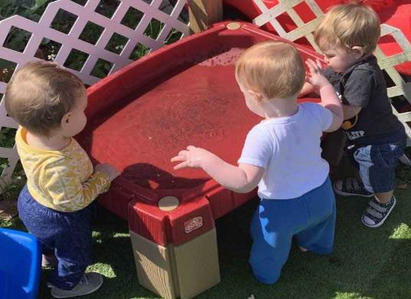
Infant Care
Nursing Room
Infants are fed on demand or according to instructions received from parents.
Due to the DCF one-hour policy of not allowing milk to sit out; prepare a greater number of smaller bottles to avoid waste of breast milk or formula.
Teachers will not offer solid foods to infants younger
than six months.

Slide 13
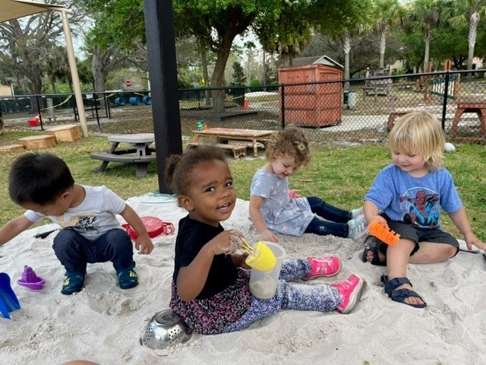
Outdoor Learning
Weather permitting, children will go outside
several times a day
Casual, comfortable clothing, which can be managed easily by the child, is recommended
Please label all clothing with your child’s name. We recommend to bring a minimum of 2 sets of extra clothes for younger children, in case of accidents or water play.
Parents/Guardians will apply initial application of their child’s sunscreen in the morning (before arrival). CSC staff will apply sunscreen before going out in the afternoon. (Please sign sunscreen authorization)

Slide 14
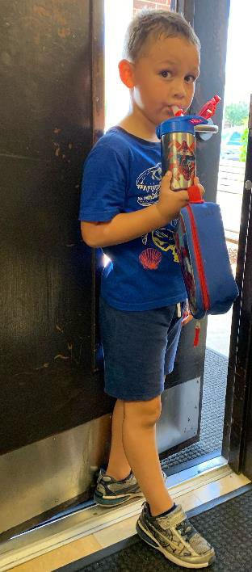
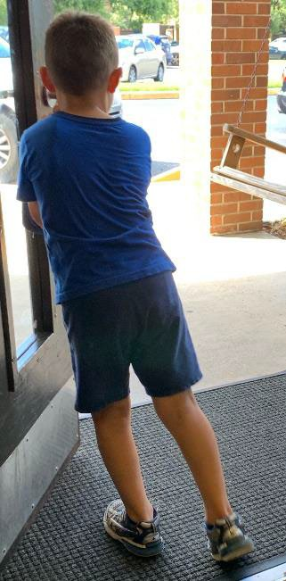
Arrival and Departure
Parking lot can be crowded.
Parents are required to see a teacher before dropping off a child or picking up a child.
Staff will never allow departure with someone who has not been authorized by parents.
ID must be provided.
Parents are required to sign- in and sign-out on Procare.

Slide 15
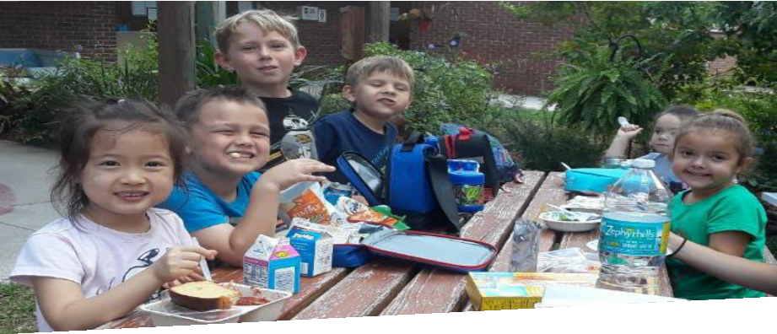
Meals
During the Fall and Spring, parents/guardians are responsible to bring a nutritious lunch. Milk is included in your child’s tuition and will be served daily at lunch.
During the Summer, parents/guardians are responsible for providing a 3:00pm snack for their child.
Meal times are comfortable and social skills are encouraged.
All food-related allergies must be brought to the attention of CSC staff.
Creative School is a 'Peanut Free Facility', other nut butters are permitted.

Slide 16
Meal Restrictions
"NEVER" FOODS: CHOKING HAZARDS:
The following foods are not allowed at school:
These foods are choking hazards for children under 4 years old:
Soft Drinks
Candy
Gum
Cake
Donuts
Cookies
Chips
Sugared drinks/cereals
Nuts
Popcorn
Whole grapes
Whole hot dogs
Raw peas
Hard pretzel sticks

Slide 17
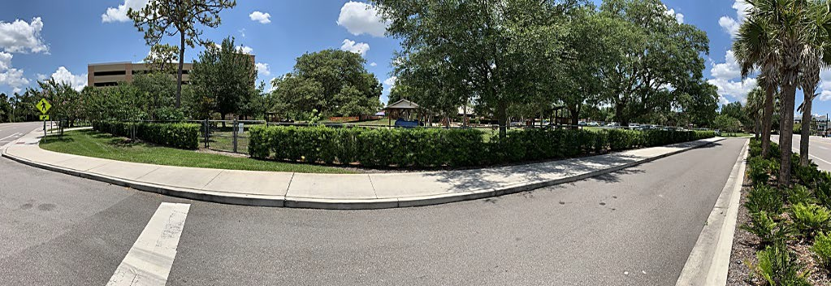
Emergency Information
Current emergency contact information must be on file.
The evacuation On-Site location meeting area is the outside learning environment fence along Libra Drive.
Safety drills are completed for fire, tornado, hurricane, earthquakes, and intruders.
The evacuation Off-Site location meeting area is the UCF Recreation & Wellness Center room 135.

Slide 18
Health and Safety
We receive quarterly visits from our local health department and our state childcare licensing agency to ensure that we are delivering the best in health and safety practices.
At least one CSC staff member in each classroom is CPR and First Aid Certified.
In the event of a medical accident/emergency, CSC staff will follow these procedures:
Assess the immediate situation and determine if the child is ill or injured, the extent of the injury, and whether first aid is needed (to assure breathing, control bleeding, and limit further injury.)
Determine a course of action, to include utilizing procedures listed below, notifying the Parent/ Guardian, or contact paramedic services (as needed) to transport the child to the emergency room. All Parents/ Guardians are required to sign an emergency medical authorization allowing staff to obtain emergency medical treatment in their absence.
Staff may use the following procedures with a child:
Wash a minor cut, scrape, or puncture with soap and water and apply a bandage from first aid kit.
Apply ice to a bump to reduce swelling and bruising.
Ask a child to sit or lay down until the Parent/ Guardian arrives. An adult will remain with the child until the Parent/ Guardian arrives.
Disposable gloves will be used if a child is bleeding; a micro shield will be used for mouth-to-mouth breathing.
The center is equipped with an automated external defibrillator (AED) machine, in case of a cardiac arrest.

Slide 19
Parents will be called in the event of their child becoming ill and are expected to pick up within 30 minutes.
Illness Policies
Children may return to CSC after they and their household are fever/symptom free for 24 hours without the use of medicine.
No medications will be given by CSC staff. If children are well enough to attend school, they need to participate in all scheduled activities (including going outside).

Slide 20
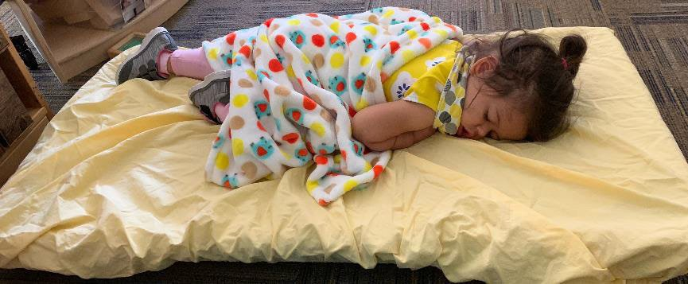
Rest Time
All children are offered a quiet nap/rest period between 12:30 pm and 2:30 pm.
Children are not forced to nap.
All sheets, pillows, and blankets must be taken home every Friday to be washed, so
your child will have fresh linen on Monday.

Slide 21
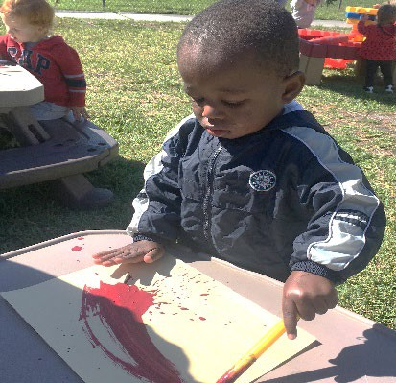
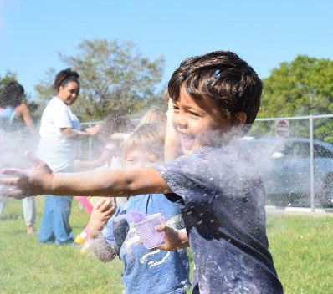
Contact Us
Telephone: (407) 823-2726
Fax: (407) 823-3096
Email: csc@ucf.edu
Website: www.csc.sdes.ucf.edu

